Slide 1


Fault-tolerance: Crash Consistency
SE124 (2021 Fall)
IPADS, Shanghai Jiao Tong University
https://www.sjtu.edu.cn

Slide 2
Review: scalable websites
Scalable websites powered by distributed systems
For request handling, data storage (lecture xx & xx)
Caching server
Caching server
Caching server
…
Caching
Caching
Caching
Distributed caching
Database server
Database server
CDN
Users
Application #1
generate the page
Database
user, price
…
Database
user, price
Application server
Distributed database
Internet
Load
Balance
Application #2
add the order
File server
File server
File server
File:
image
File:
image
…
File:
image
Application server
…
…
Message queue
Distributed file system

Slide 3

Review: Key-value store
Database
File system
Key-value store

Slide 4



Review: Key-value store
Storage layout:
Each data (Value) is opaque to the database
Indexed by a key (K), which itself is also a data (e.g., int, string)
Interface
Get(K) -> V, Scan(K,N)
Update(K,V), Insert(K,V), Delete(K,V)
The K and V can be arbitrary byte-sequence (e.g., JSON)
Though simple, sufficient and thus, popular nowadays

Slide 5
Review: Building Key-value Stores on File System
Why builds upon the file system?
We still needs file system to manage disk hardware
“All problems in computer science can be solved by another level of indirection” -- often attributed to Butler Lampson, who attributes it to David Wheeler
Key-value Store
Key-value files
File system

Slide 6
Review: Key Techniques for building Key-value Stores
Log-structured file
A file that contains append-only records
Friendly to the underlying disk storage when writing
Not efficient when reading
Indexing
E.g., Hashing, B-trees
Accelerate reading
Support range-query
LSM Tree

Slide 7
Review: LSM Tree
SSTables
Fixed-sized log structured file
(key, value)s are sorted in a SSTable
MemTable
Temporal store updates/insertions in DRAM
Simplify order maintaining
MemTable
New
L0
L1
L2
LSM Tree
Old

Slide 8
Challenge of previous designs
How to handle failures?

Slide 9
Example: LSM updates
MemTable
KV pairs
Memory
Disk
Level₀
…
…
SSTable
Level₁
KV pairs
(sorted)
…
Level_{k}
…
Metadata

Slide 10
Example: LSM updates
MemTable
KV pairs
Memory
Disk
Level₀
…
…
SSTable
Level₁
KV pairs
(sorted)
…
Level_{k}
…
Metadata

Slide 11
Example: LSM updates
MemTable
KV pairs
Full
Memory
Disk
Level₀
…
…
SSTable
Level₁
KV pairs
(sorted)
…
Level_{k}
…
Metadata

Slide 12
Example: LSM updates
MemTable
KV pairs
Full
Memory
Q-1: What happens to KVs in the MemTable after crash?
Disk
Level₀
…
…
SSTable
Level₁
KV pairs
(sorted)
…
Level_{k}
…
Metadata

Slide 13
Example: LSM updates
MemTable
KV pairs
Full
Memory
Disk
Q-2: what happen if a crash occurs between we append to a file?
Level₀
…
…
SSTable
Level₁
KV pairs
(sorted)
…
Level_{k}
…
Metadata

Slide 14
Crash consistency
Of our inode-based file system

Slide 15
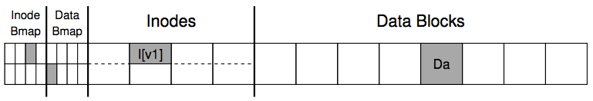
Recall the Example of Appending a File
Inside of I[v1]:
owner : yubin
permissions : read-only
size : 4000
pointer : 4
pointer : null
pointer : null
pointer : null
Inside of I[v2]:
owner : yubin
permissions : read-only
size : 5000
pointer : 4
pointer : 5
pointer : null
pointer : null

Slide 16
Recall the Example of Appending a File
Appending to a file uses (possible) multiple disk writes
Assumption: one disk write never fails, i.e., no partial write
Steps for appending a file
Write the data block to the disk
Write the inode to the disk
Write the bitmap to the disk

Slide 17
Crash Scenarios: 1 Succeeds
Appending to a file uses (possible) multiple disk writes
Assumption: one disk write never fails, i.e., no partial write
Steps for appending a file
Write the data block to the disk
Write the inode to the disk
Write the bitmap to the disk
What will happen?

Slide 18
Crash Scenarios: 1 Succeeds
Appending to a file uses (possible) multiple disk writes
Assumption: one disk write never fails, i.e., no partial write
Steps for appending a file
Write the data block to the disk
Write the inode to the disk
Write the bitmap to the disk
What will happen?

Slide 19
Crash Scenarios: 1 Succeeds
Appending to a file uses (possible) multiple disk writes
Assumption: one disk write never fails, i.e., no partial write
Steps for appending a file
Write the data block to the disk
Write the inode to the disk
Write the bitmap to the disk
What will happen?

Slide 20
Crash Scenarios: 2 Succeed
Two writes succeed and the last one fails:
Write the data block to the disk
Write the inode to the disk
Write the bitmap to the disk
What will happen?

Slide 21
Our expectation: consistency
After rebooting & running recovery code
1. FS internal invariants maintained
E.g., no block is both in free list and in a file
2. All but last few operations preserved on disk
E.g., data I wrote yesterday are preserved
User might have to check last few operations
3. No order anomalies
$ echo 99 > result ; echo done > status

Slide 22
Approaches: Recovering FS Metadata from Crash
1. Synchronous meta-data update + fsck
During check, synchronize metadata, such as file size
2. Soft update (FreeBSD fs modified on FFS)
not covered in this course
3. Logging (ext 3/4), and many others
Before doing actual meta-data update, log the event
After crash, recover from log

Slide 23
Sync Metadata Update + fsck

Slide 24
What does fsck do?
1. Check superblock
E.g., making sure the file system size is greater than the number of blocks allocated
If error, use an alternate copy of the superblock
2. Check free blocks
Scans the inodes, indirect blocks, double indirect blocks, etc.
Uses this knowledge to produce a correct version of the allocation bitmaps
Same for the inode bitmap

Slide 25
What does fsck do?
3. Check inode states
Check type: regular file, dir, symbolic link, etc.
Clear suspect inodes and clear the inode bitmap
4. Check inode links
Check link count by scanning the entire fs tree
If count mismatches, fix the inode
If inode is allocated but no dir contains it, lost+found
5. Check duplicates
Two inodes refer to the same block
If one inode is obviously bad, clear it; otherwise, copy the block and give each a copy

Slide 26
There are more to check
6. Check bad blocks
E.g., point to some out-of-range address
What should fsck do? Just remove the pointer
7. Check directories
The only file that fsck know more semantic
Making sure that "." and ".." are the first entries
Ensure no dir is linked more than once
No same filename in one dir

Slide 27

Problem of fsck: Too Slow
How long would fsck take?
an example server: fsck takes 10 minutes per 70GB disk w/ 2 million inodes
clearly reading many inodes sequentially, not seeking
still a long time, probably linear in disk size
Consider the example before:
Scan the disk for only three disk block writes
Just like find a key by searching the entire house

Slide 28
What's the right order of synchronous writes?
If the order is wrong, fsck may recover unexpectedly
File creation
1. mark inode as allocated
2. create directory entry
File deletion
1. erase directory entry
2. erase inode addrs[], mark as free
3. mark blocks free
Assumption: each write is synchronous
Execute sequentially

Slide 29
What's the right order of synchronous writes?
If the order is wrong, fsck may recover unexpectedly
File creation
2. create directory entry
1. mark inode as allocated
The checks of fsck
2. Check free blocks
Scans the inodes, indirect blocks, double indirect blocks, etc.
Uses this knowledge to produce a correct version of the allocation bitmaps
Same for the inode bitmap
Will the file be recovered after fsck?

Slide 30

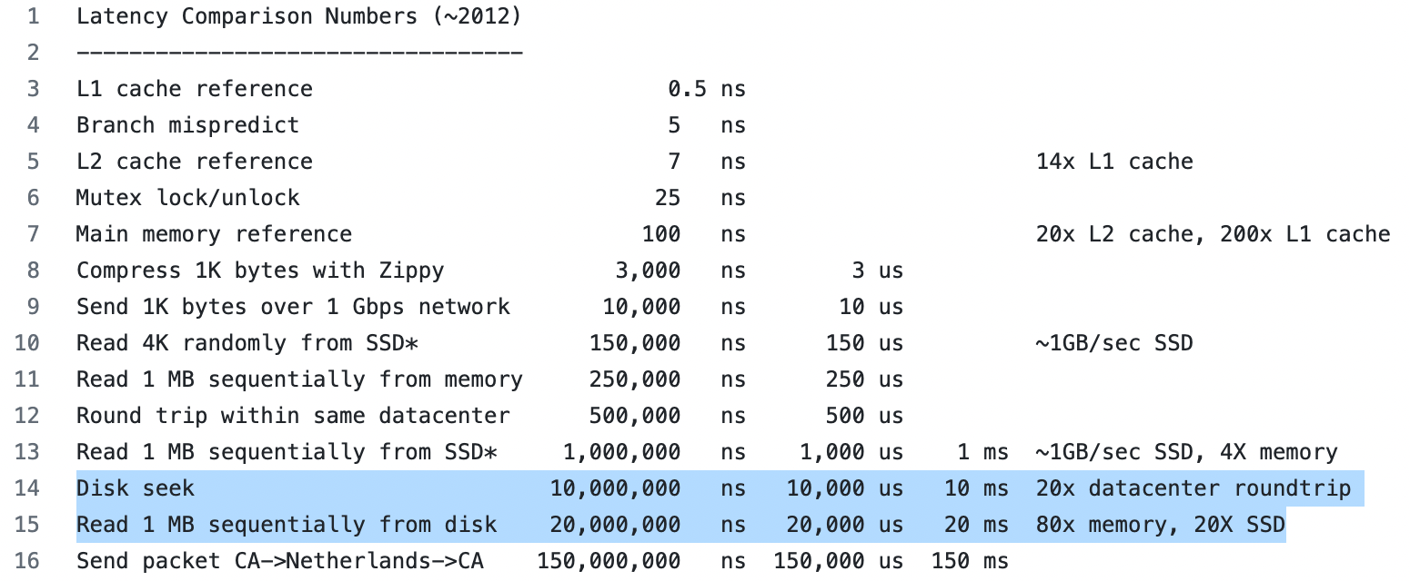
Issues with Synchronous Write
Very slow during normal operation
Very slow during recovery
Latency Numbers Every Programmer Should Know (github.com)

Slide 31
Ordinary perf. of sync meta-data update?
Creating a file and writing a few bytes
Takes 8 disk writes, probably 80 ms
(ialloc, init inode, write dirent, alloc data block, add to inode, write data, set length in inode, ...)
Can create only about a dozen small files per second!
Think about un-tar or rm *

Slide 32
How to get better performance?
Reality:
RAM is cheap
Disk sequential throughput is high, e.g., 200 MB/sec or more
Write-back cache

Slide 33

How to get better performance?
Reality:
RAM is cheap
Disk sequential throughput is high, e.g., 200 MB/sec or more
Use a big write-back cache?
No sync meta-data update operations
Only modify in-memory disk cache (no disk write)
creat(), unlink(), write(),etc., return almost immediately
If cache is full, write LRU dirty block
Write all dirty blocks every 30 seconds, to limit loss if crash
This is how Linux EXT2 file system worked

Slide 34
Write-back Cache
Would write-back cache improve performance?
Why performance would be improved?
After all, you have to write the disk in the end anyway

Slide 35
What can go wrong with write-back cache?
unlink() followed by create() an existing file x with some content, all safely on disk
One user runs unlink(x)
1. delete x's directory entry **
2. put blocks in free bitmap
3. mark x's inode free; another user then runs create(y)
4. allocate a free inode
5. initialize the inode to be in-use and zero-length
6. create y's directory entry **
again, all writes initially just to disk buffer cache
suppose only ** writes forced to disk, then crash
What is the problem? Can fsck detect and fix this?

Slide 36
Logging / Journaling

Slide 37
Journaling overview
Write-ahead Logs
A concept from database
Record before update
Record changes in journal
Commit journal
Update
Crash before commit:
- No data is changed
- Discard journal
Crash after commit:
- Journal is complete
- Redo changes in journal

Slide 38
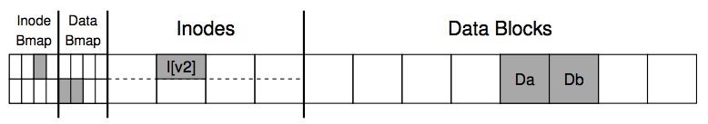
Append a File via Journaling
Inside of I:
owner : yubin
permissions : read-only
size : 1
pointer : 4
pointer : null
pointer : null
l:
size: 1=>2
2nd pointer: null => 5
Db:
Old-data… => Appended-data…
COMMITTED
=> 2
=> 5
Journal

Slide 39
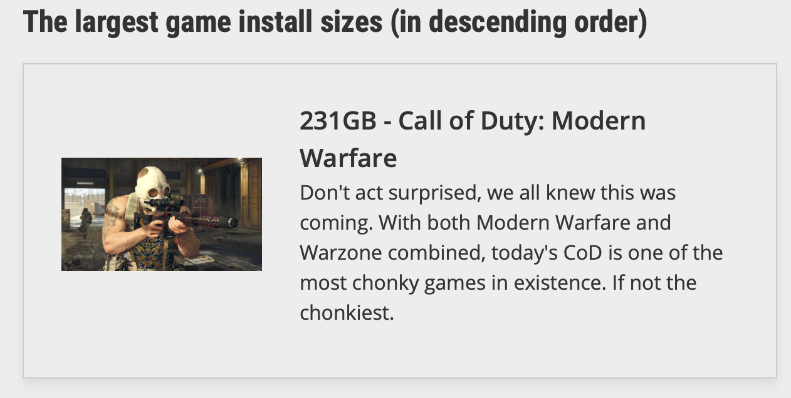
Journaling Drawbacks
Everything is written to the disk twice
Once in the journal
The other at the home location
The problem: files are large

Slide 40
Mitigating Journaling Drawbacks
Observation:
Not everything in file system has equal importance
Usually, the metadata is more important
Mitigation:
Only protect metadata via Journaling
Data is written only once
What if data is also important?
Ext4 options: data=journal/ordered/writeback

Slide 41
Example: Ext4 Data Journaling Mode
Writeback mode
Only the metadata is journaled
The data is written to the file on the disk
Ordered mode
The data is written first before the metadata is journaled
Data mode: full journaling
Both the metadata and file contents are journaled
Default and most commonly used

Slide 42
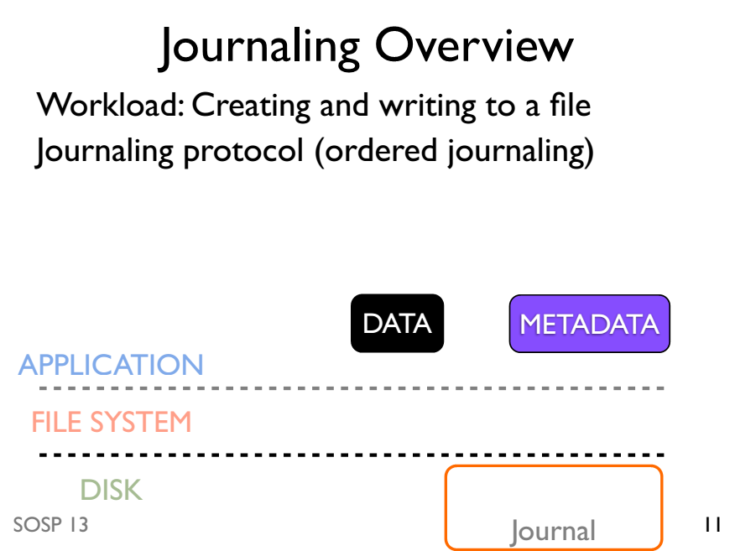

Slide 43
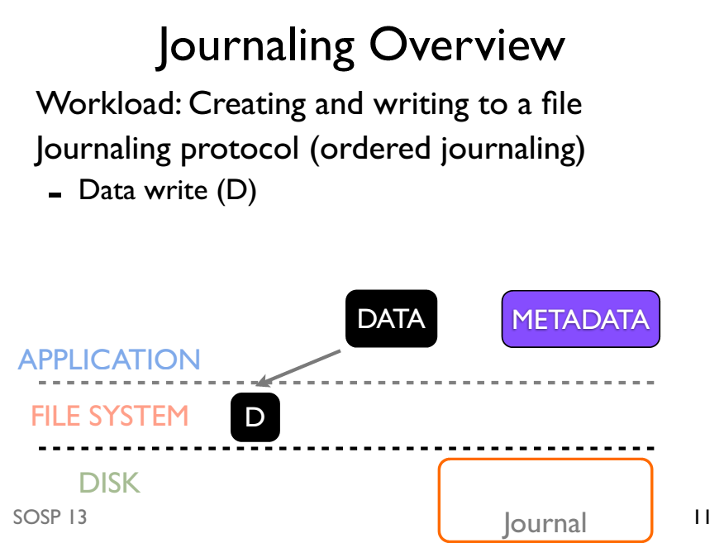

Slide 44
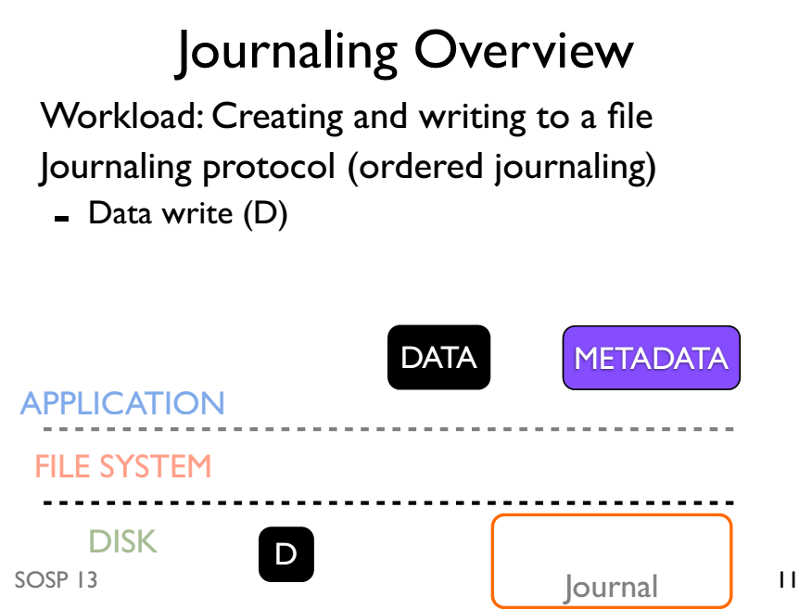

Slide 45
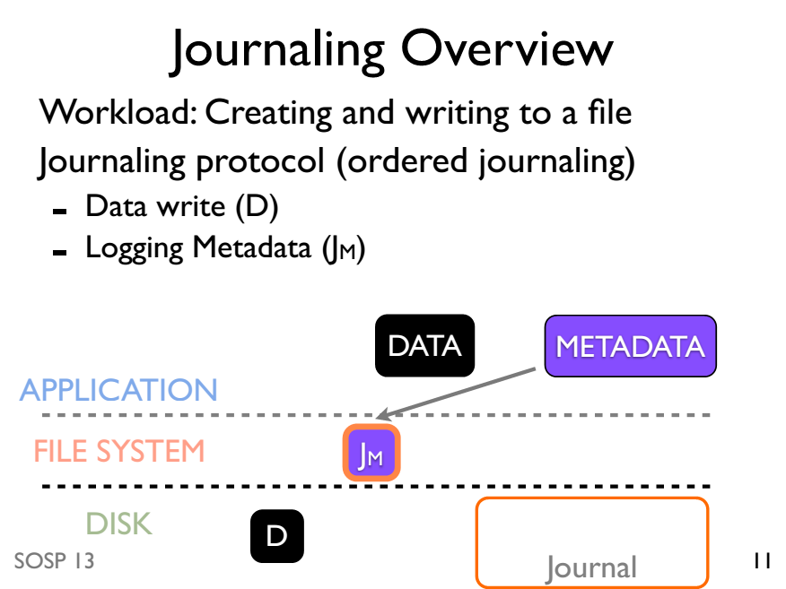

Slide 46
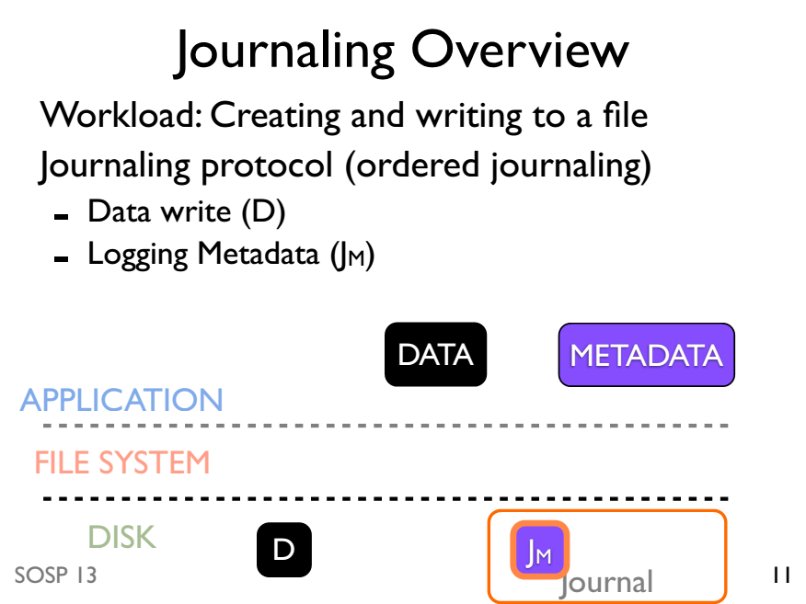

Slide 47
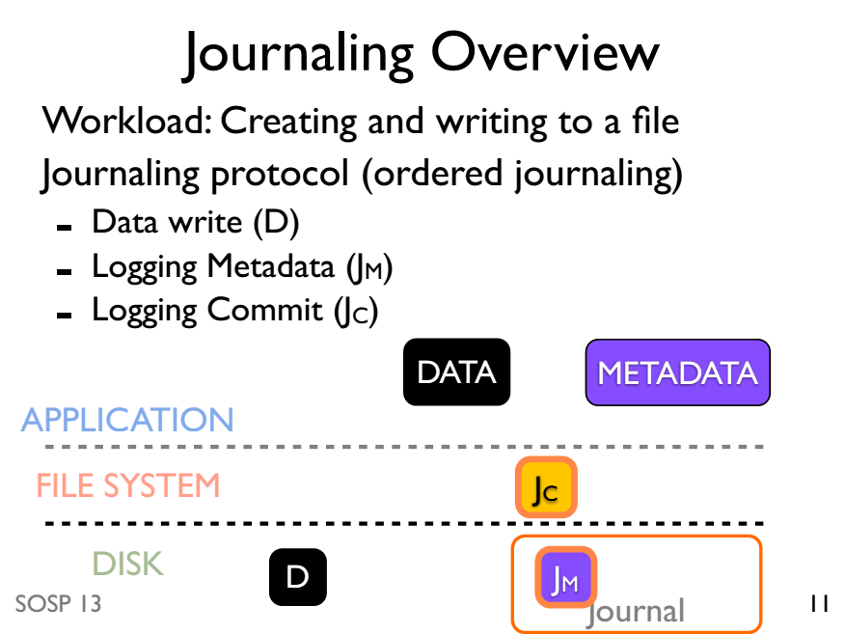

Slide 48
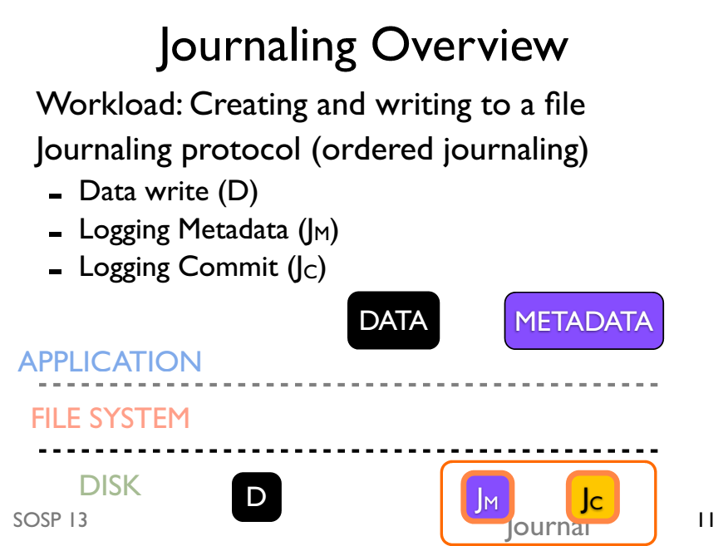

Slide 49
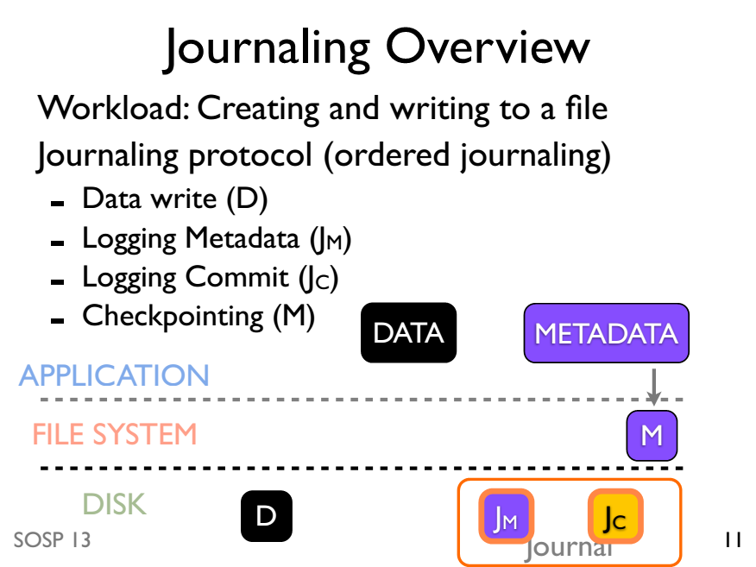

Slide 50
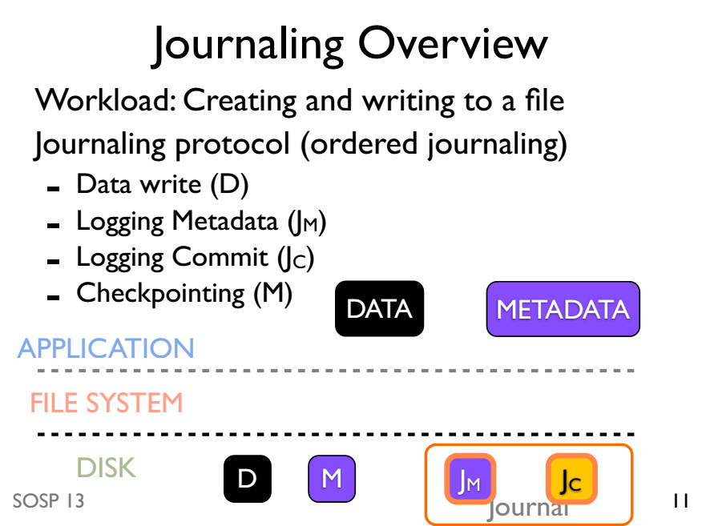

Slide 51
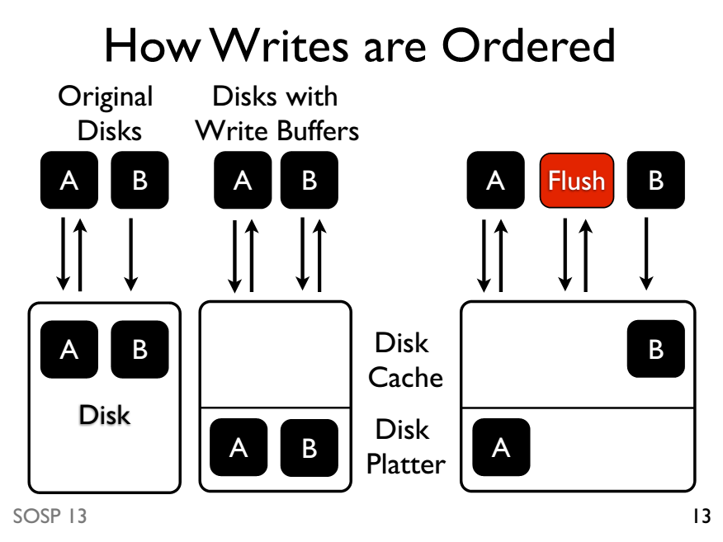

Slide 52
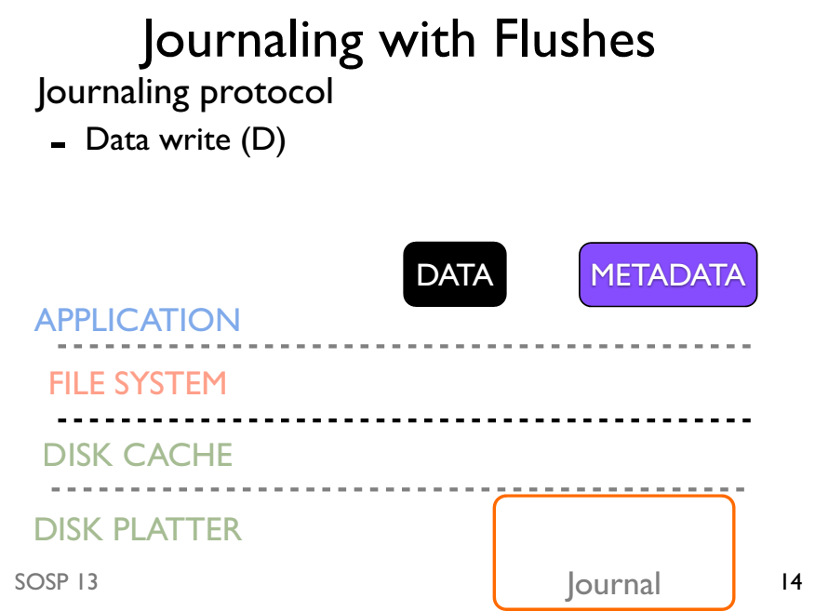

Slide 53
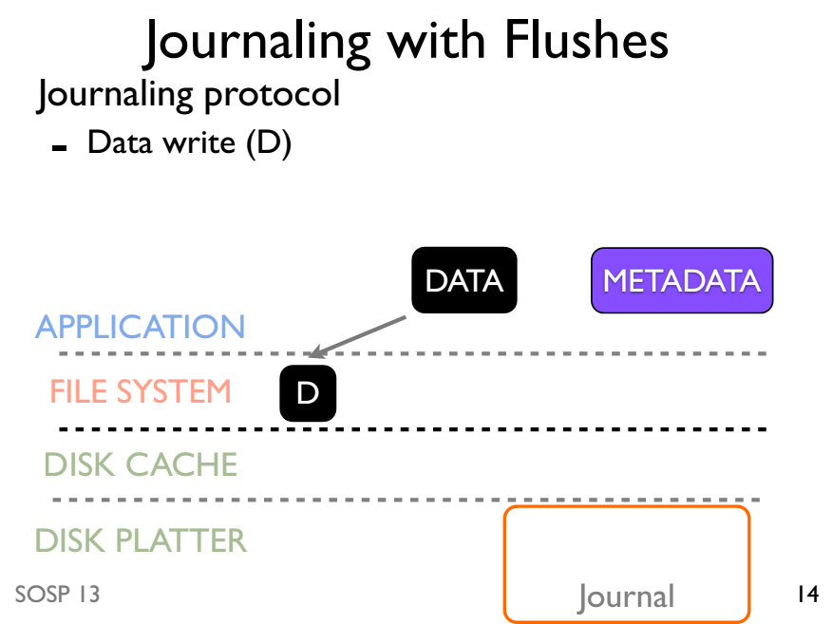

Slide 54
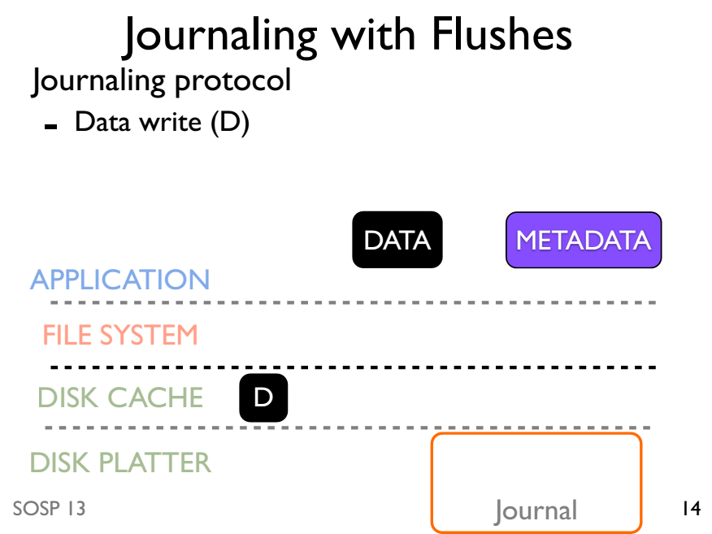

Slide 55
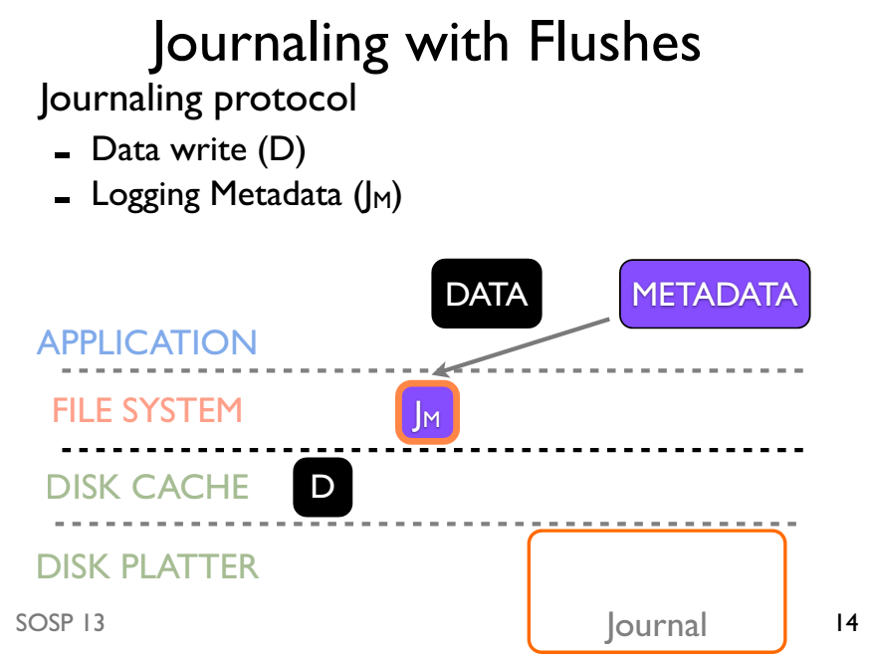

Slide 56
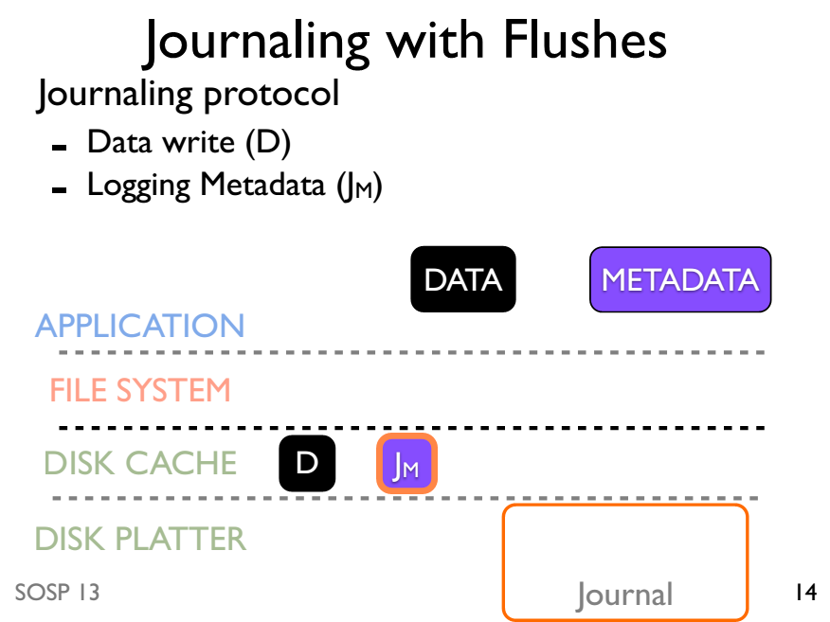

Slide 57
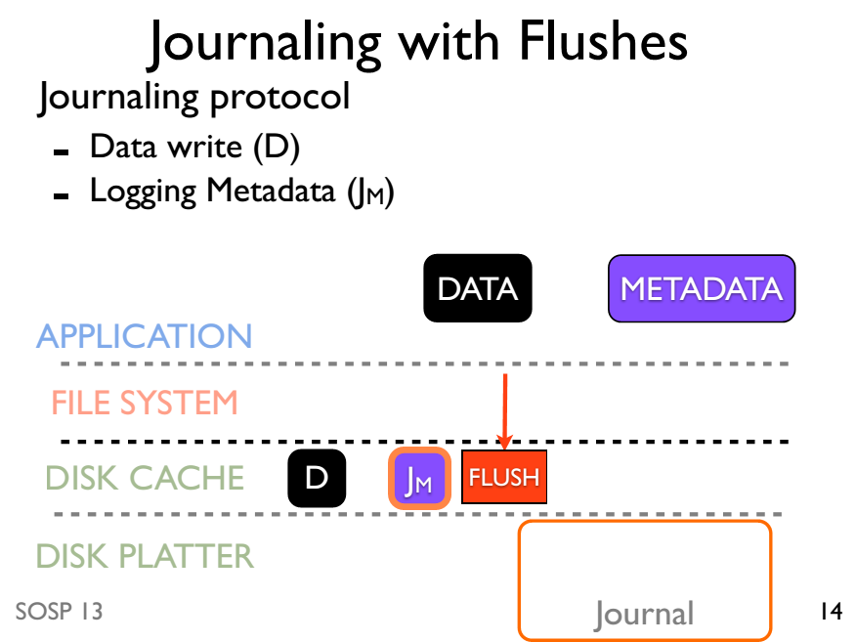

Slide 58
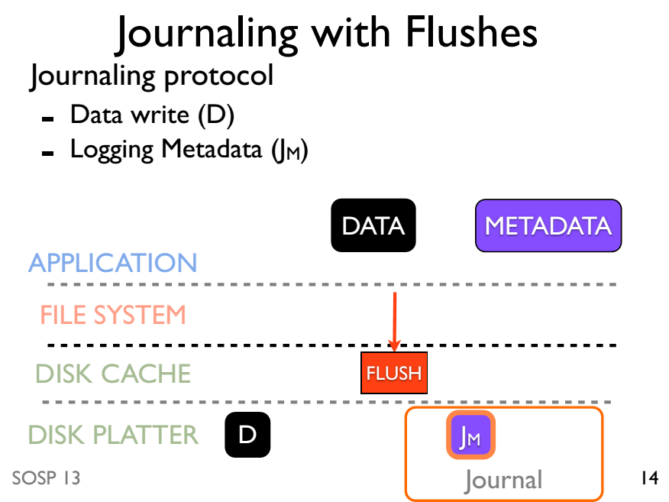

Slide 59
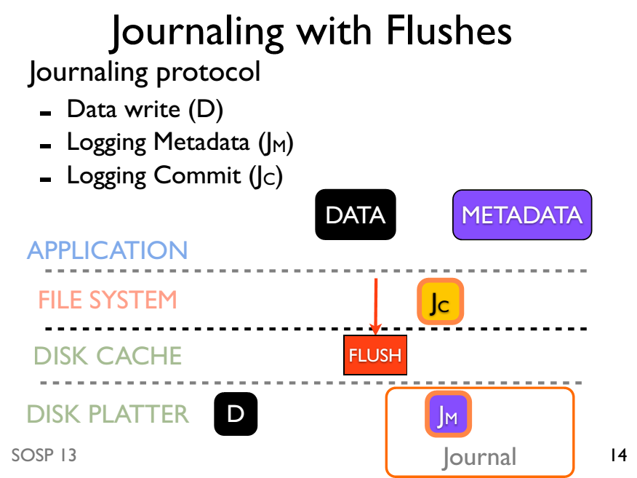

Slide 60
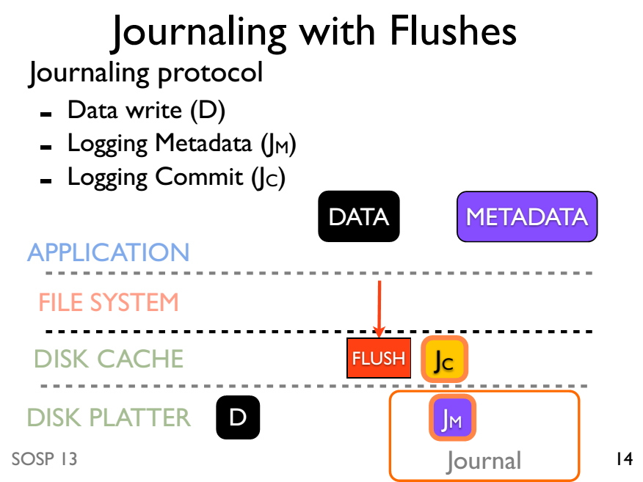

Slide 61
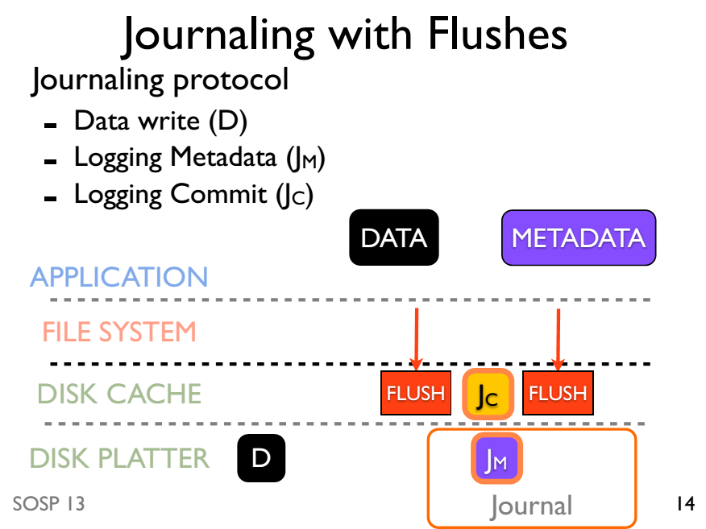

Slide 62
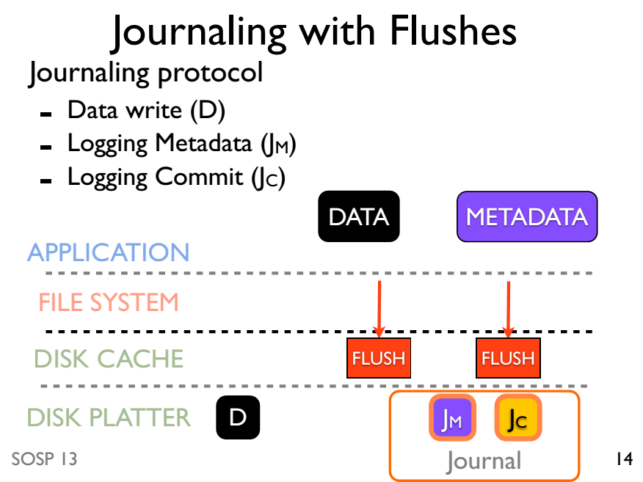

Slide 63
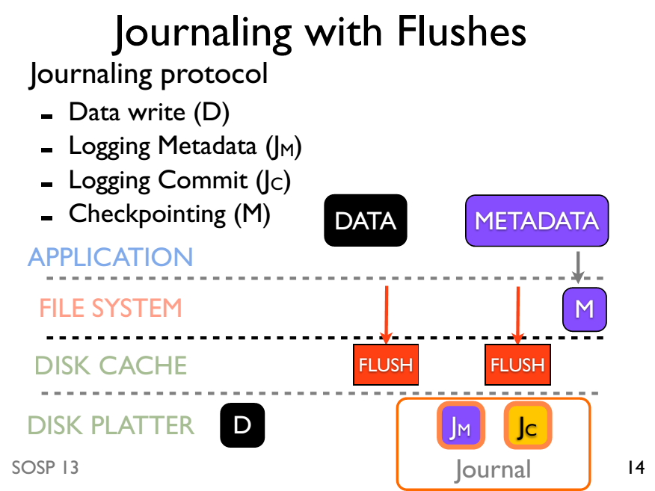

Slide 64
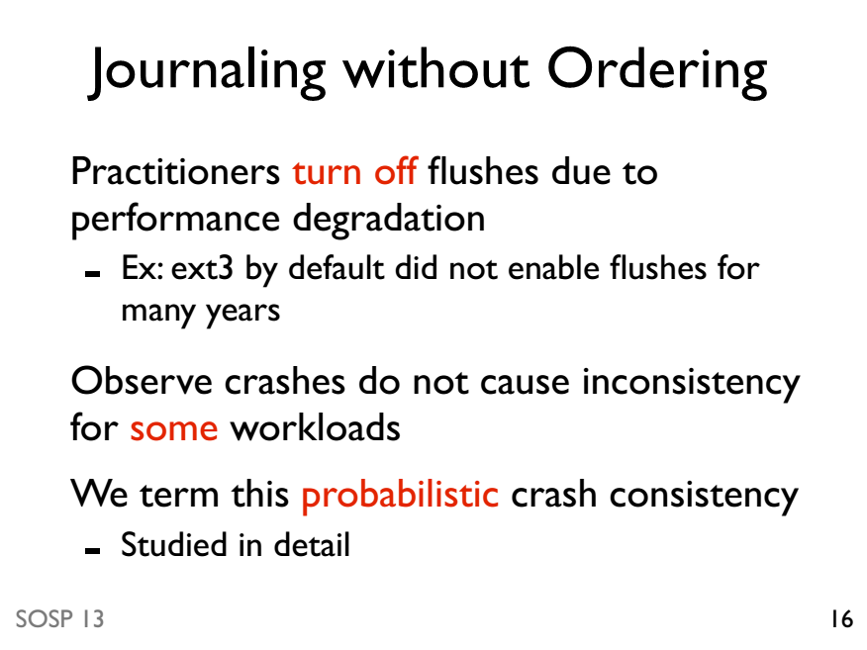
Journaling without ordering

Slide 65
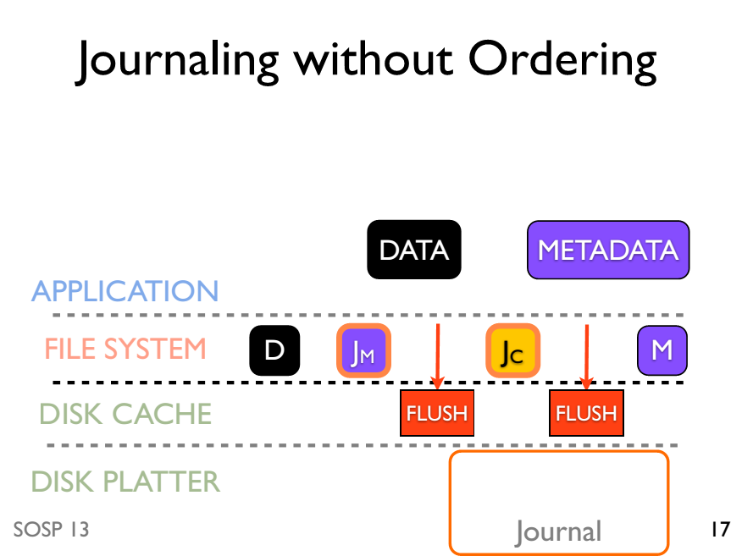

Slide 66
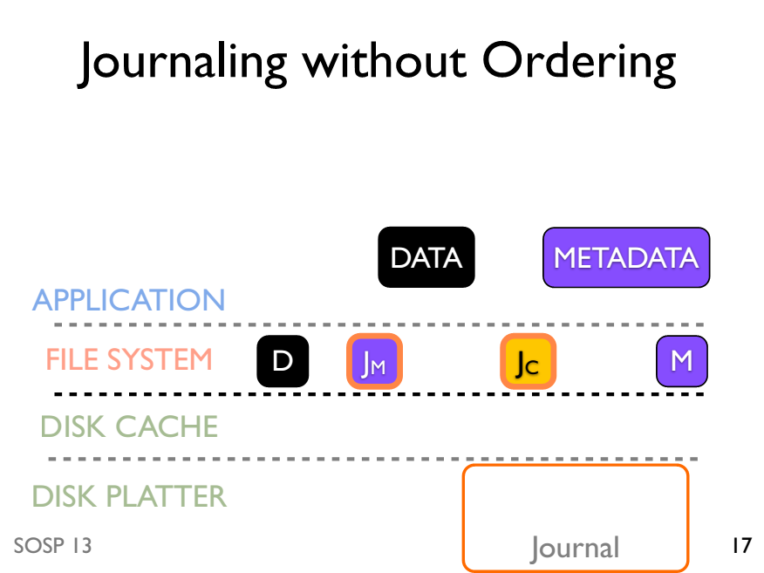

Slide 67
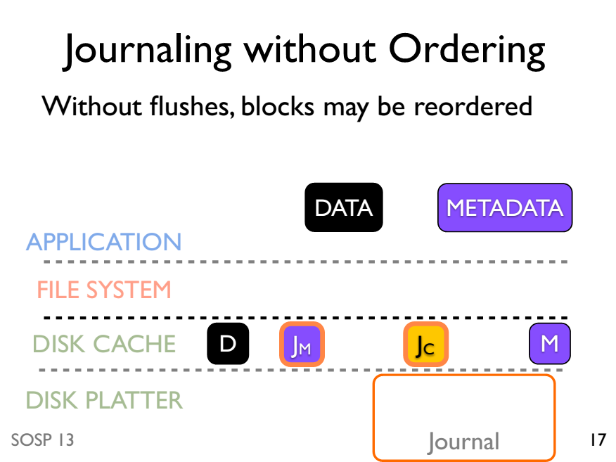

Slide 68
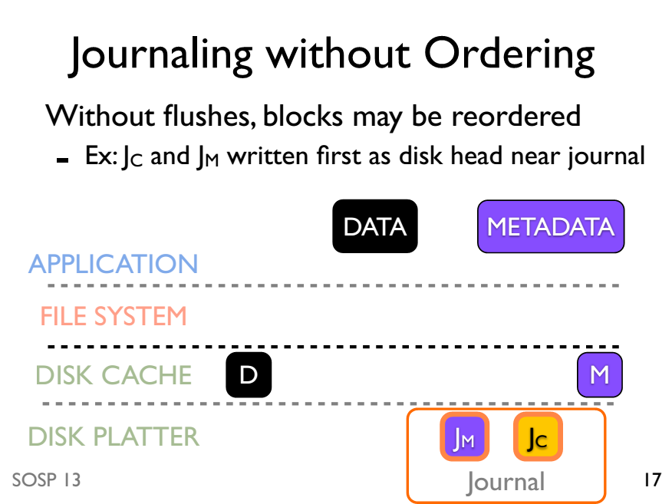

Slide 69
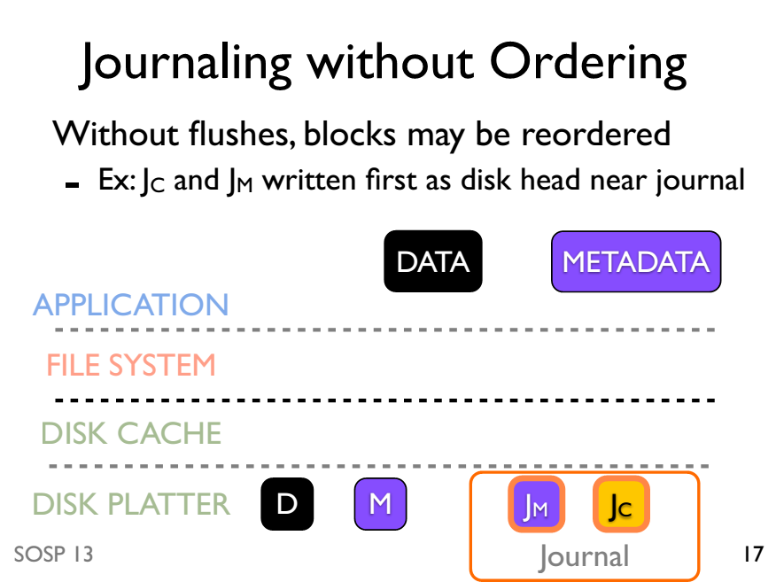

Slide 70
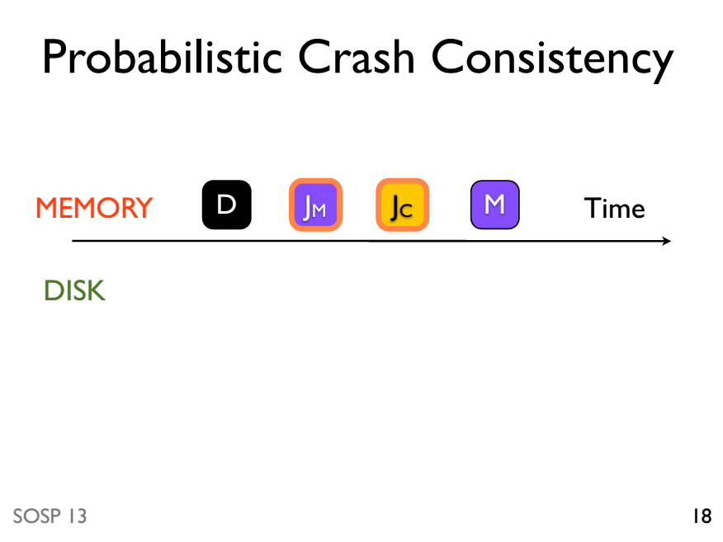

Slide 71
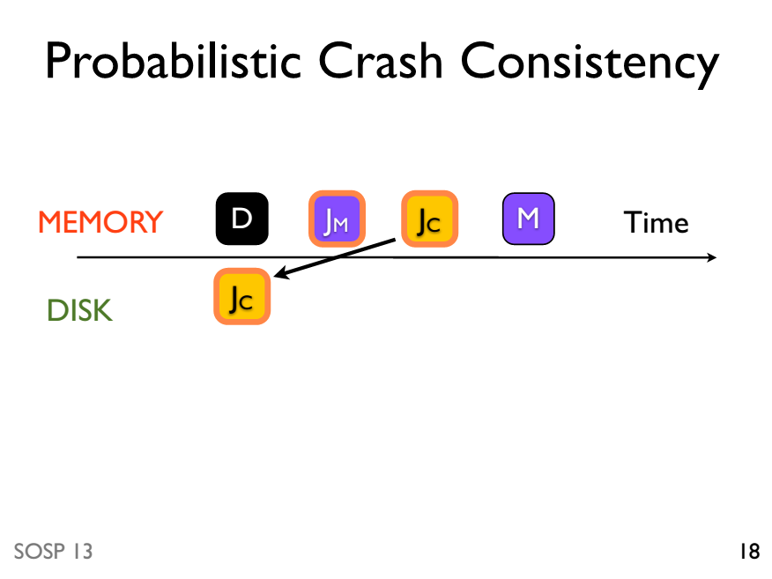

Slide 72
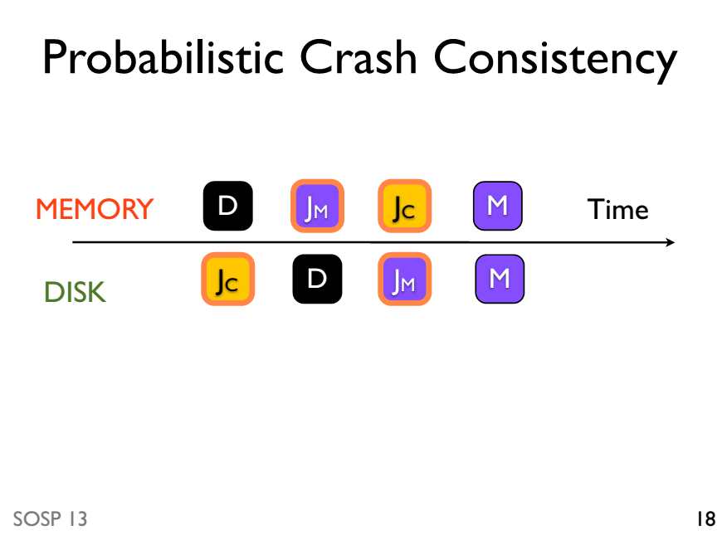

Slide 73
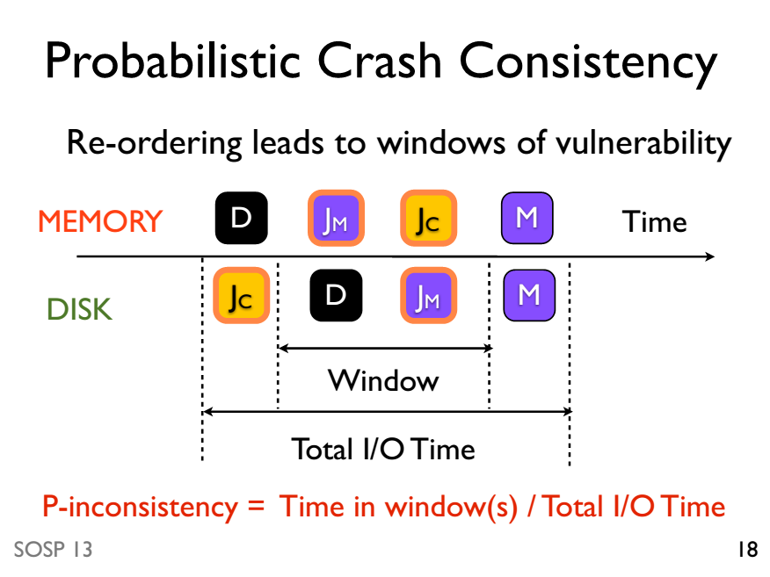

Slide 74
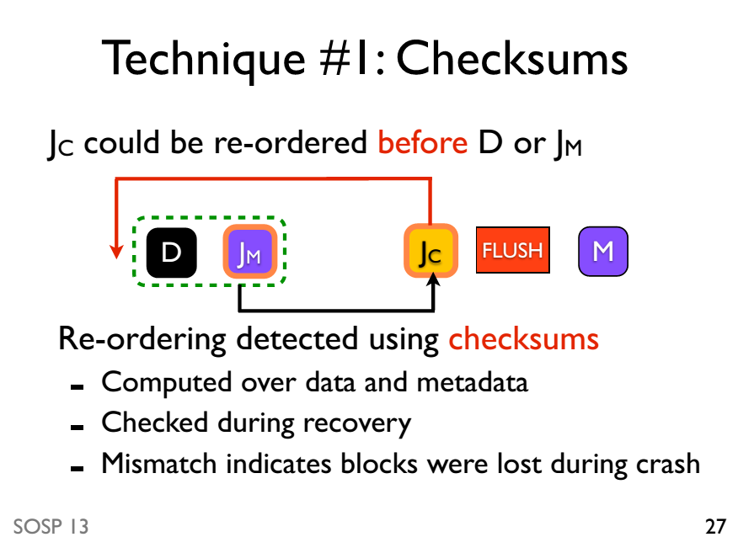

Slide 75
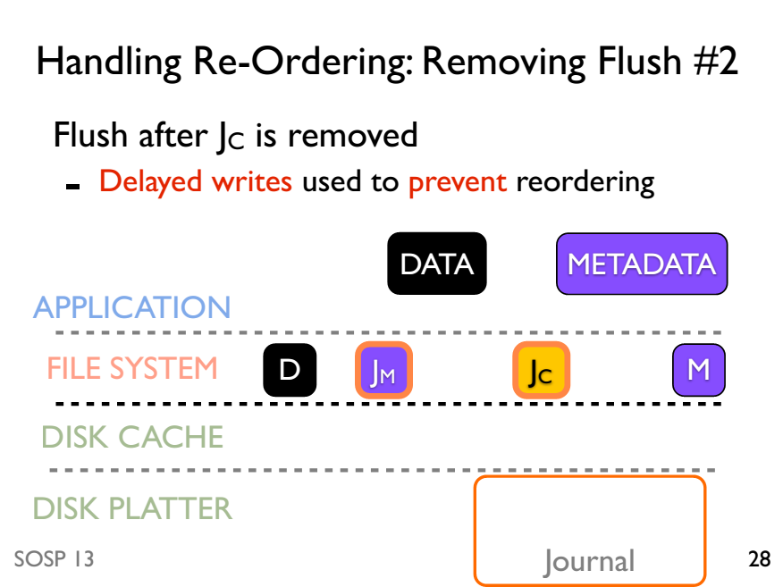

Slide 76
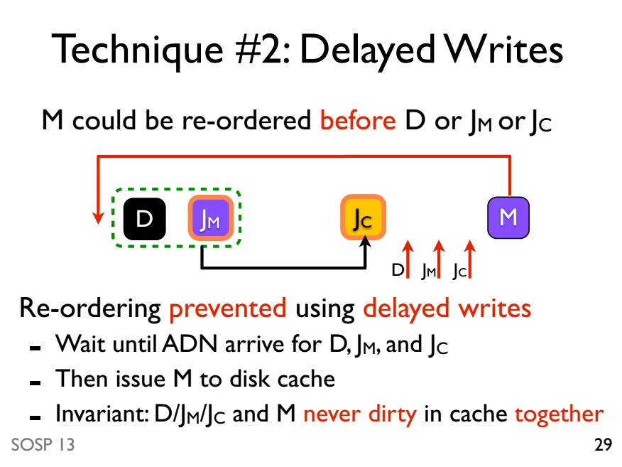

Slide 77
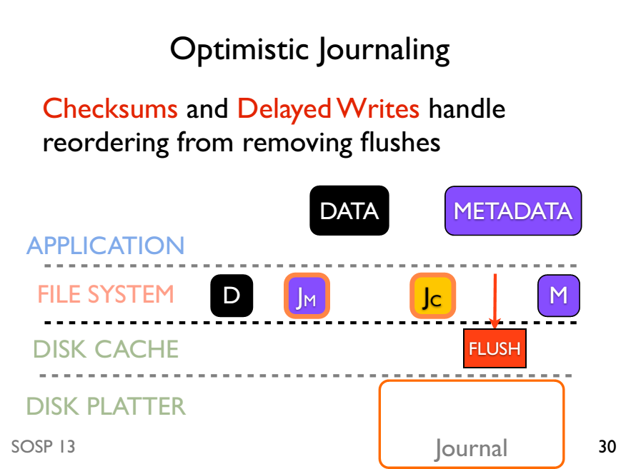

Slide 78
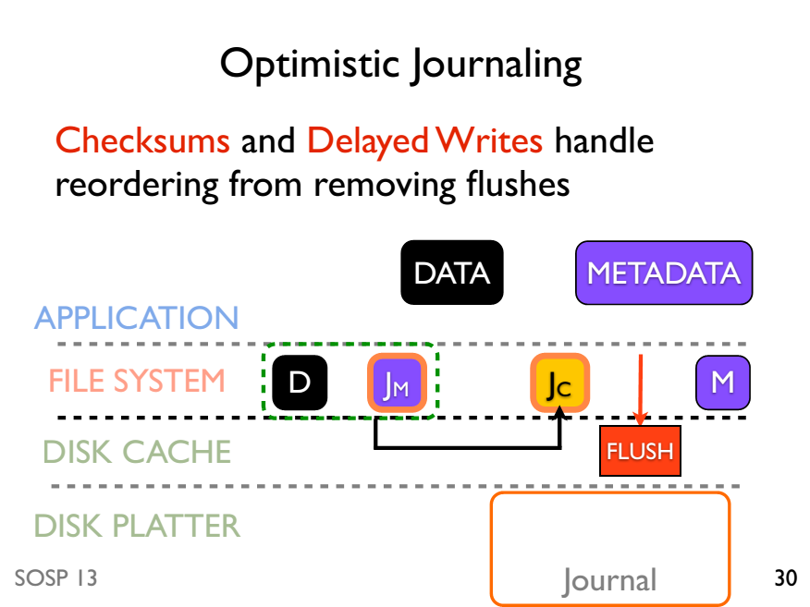

Slide 80
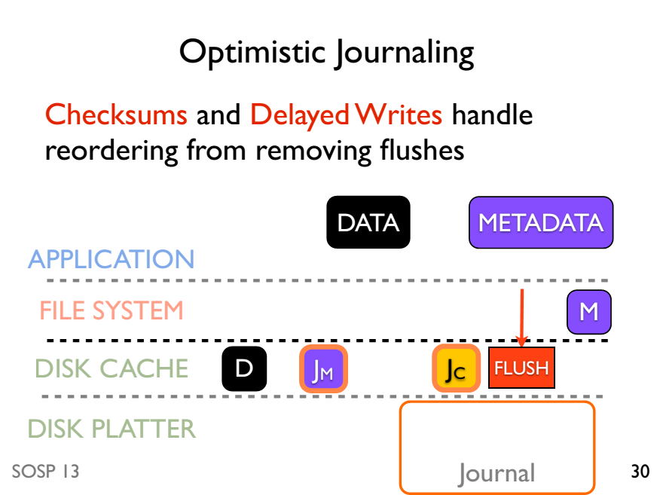

Slide 81
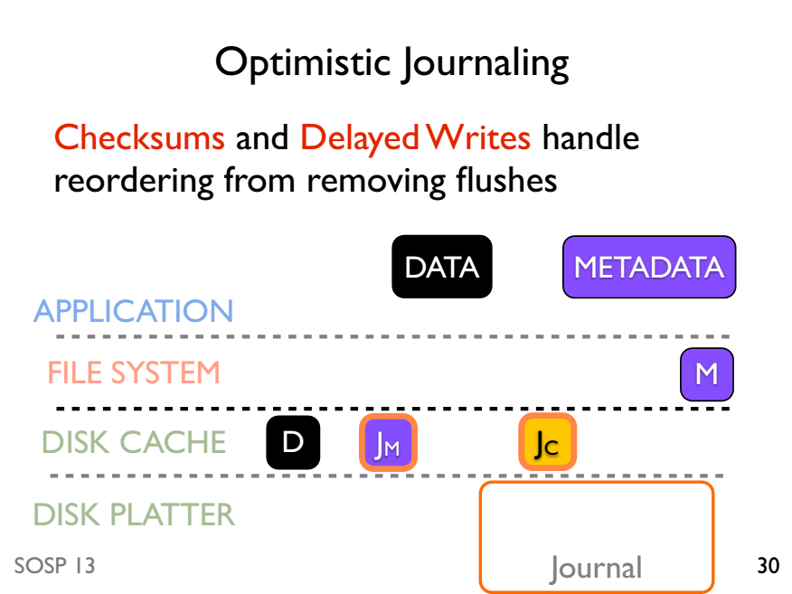

Slide 82
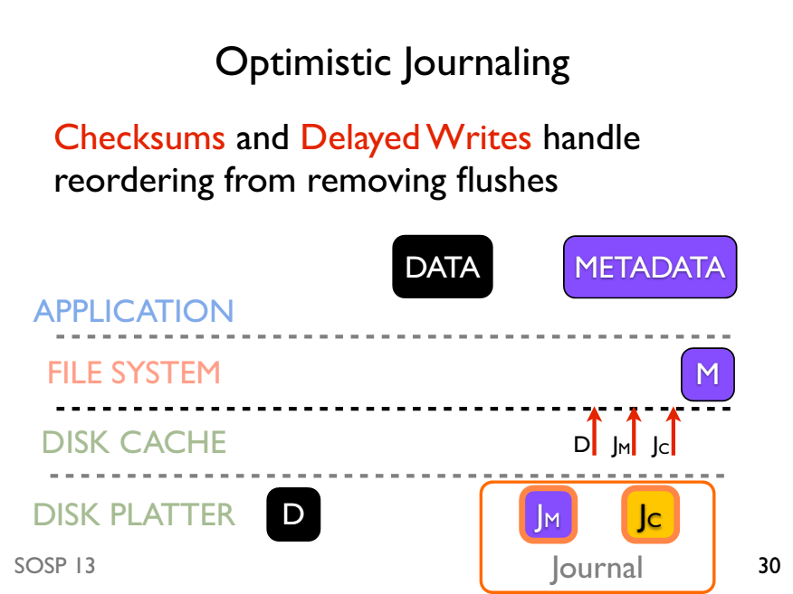

Slide 83
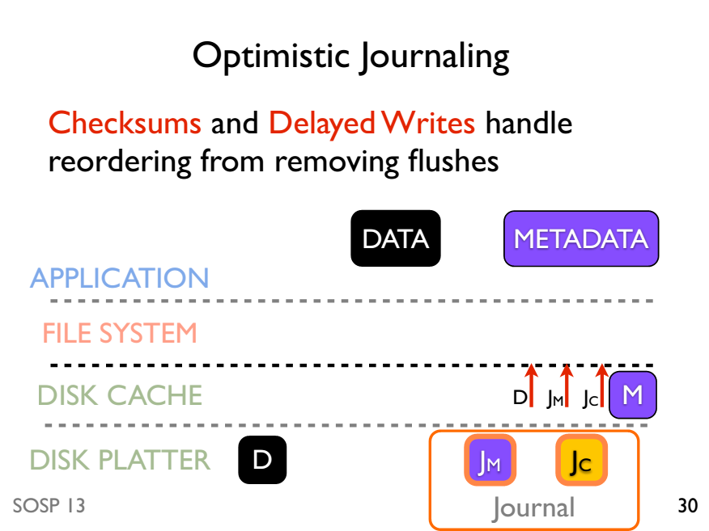

Slide 84
Results: OptFS integrates optimistic journaling
Does OptFS preserve file-system consistency after crashes?
OptFS consistent after 400 random crashes
How well does it perform?
OptFS 4-10x better than ext4 with flushes
Can meaningful application-level consistency be built on top of OptFS?
Studied gedit and SQLite on OptFS

Slide 85
Summary
Maintain crash consistency is non-trivial
Crash consistency of our inode-based file system
Fsck
Logging/Journaling

Slide 86
Question: how to make MemTable crash consistent?
MemTable
KV pairs
Full
Memory
What happens to KVs in
the MemTable after crash?
Disk
Level₀
…
…
SSTable
Level₁
KV pairs
(sorted)
…
Level_{k}
…
Metadata

Slide 87

Solution: Write-ahead Logs!
In-memory
skip list
KV pairs
Memory
Disk
Log
Head
Tail
Level₀
…
Compaction
On-disk log for recovering from failure
…
SSTable
Level₁
KV pairs
(sorted)
…
Level_{k}
…
Metadata

